Slide 1
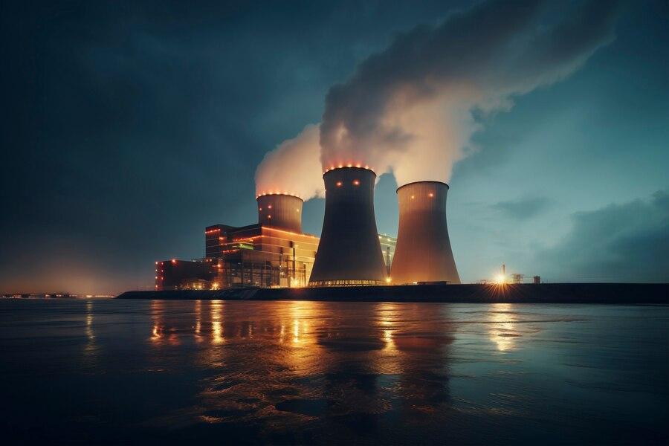
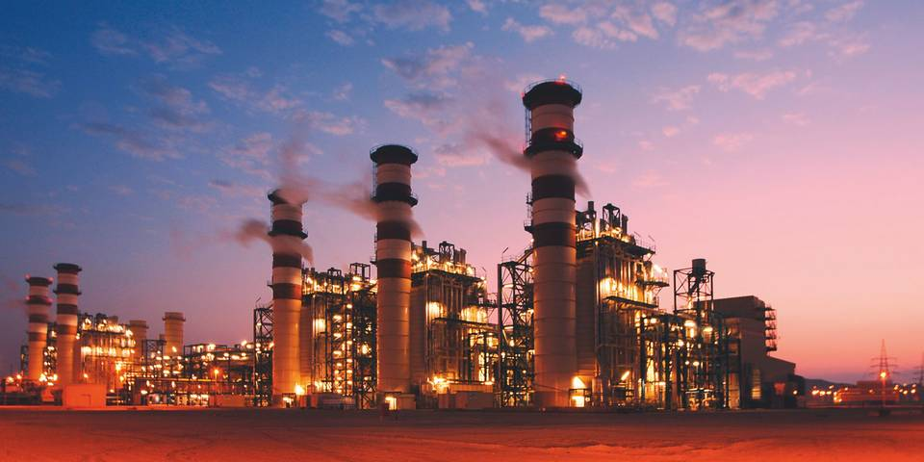

Combined Cycle Power Plant
Energy production
Group 2:
Soumya Digambar Naik
Salahudheen wafa
Suryakanta Sahoo
Ompreeth D.R.

Slide 2
OUTLINE
Introduction
Project Objectives
Dataset Information
Exploratory Data Analysis (EDA)
Data Preprocessing
Visualizations
Train & Test Split
Applying ML Algorithms
Model Evaluation
Best Model Selection
Output
Conclusion

Slide 3
INTRODUCTION
The model focuses on predicting the energy output using supervised machine learning techniques. By modelling the relationship between input features and the target variable, the model estimates the energy production for new, unseen data.
Combined Cycle Power Plants: CCPPs integrate gas and steam turbines to deliver higher efficiency and reduced emissions compared to traditional power generation methods, making them a vital component in sustainable energy production.

Slide 4
OBJECTIVES
Create a machine learning model to accurately forecast energy output based on various input features.
Analyze and optimize key input features, such as temperature, pressure, humidity, and operational parameters, to enhance prediction accuracy.
Target a specific prediction accuracy to ensure reliable energy output forecasts.
Assess the effectiveness of different machine learning algorithms in improving prediction performance.

Slide 5

DATA SET INFORMATION
The dataset comprises 9,568 rows and 5 columns. The Columns are:
Ambient Temperature: Represents the temperature of the surrounding environment, measured in degrees Celsius. It influences the efficiency of the power plant.
Exhaust Vacuum: Indicates the vacuum level in the exhaust system, affecting the energy conversion efficiency of the turbines
Ambient Pressure: Measures the atmospheric pressure, which can impact turbine performance and energy output.
Relative Humidity: Represents the amount of moisture in the air, influencing the efficiency of the cooling systems
Energy Production: The target variable representing the total energy output of the power plant, measured in megawatts (MW

Slide 6
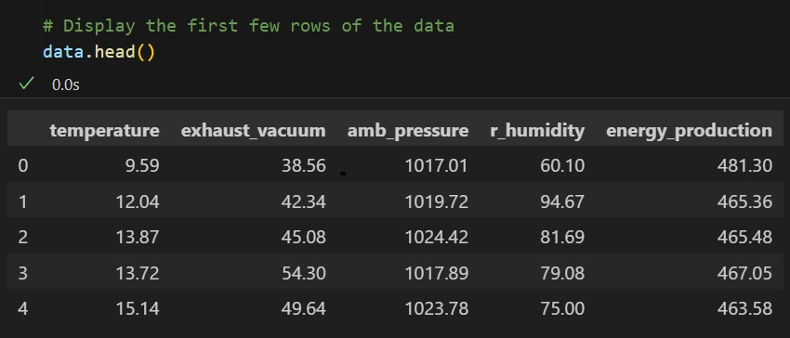
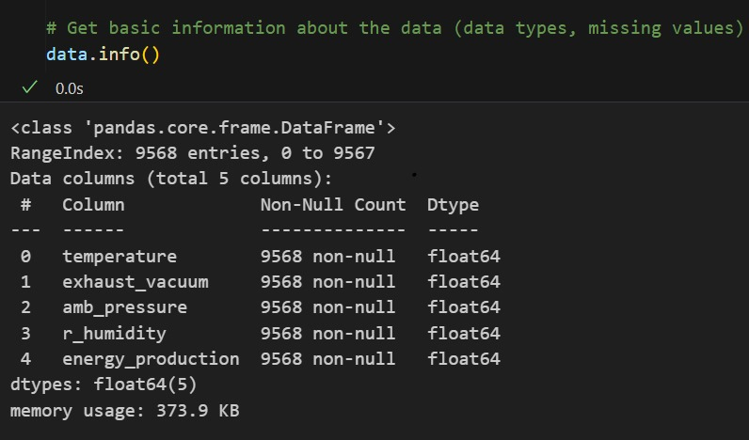
DATA SET INFORMATION

Slide 7
EXPLORATORY DATA ANALYSIS:
Identified 41 duplicated values, which will be addressed during preprocessing.
A strong positive correlation exists between Exhaust Vacuum and Ambient Temperature with Energy Production.
The high correlation (0.8) between Temperature and Exhaust Vacuum indicates potential multicollinearity, which may impact model accuracy.
Observed outliers in Ambient Pressure and Relative Humidity, which will need further investigation.

Slide 8
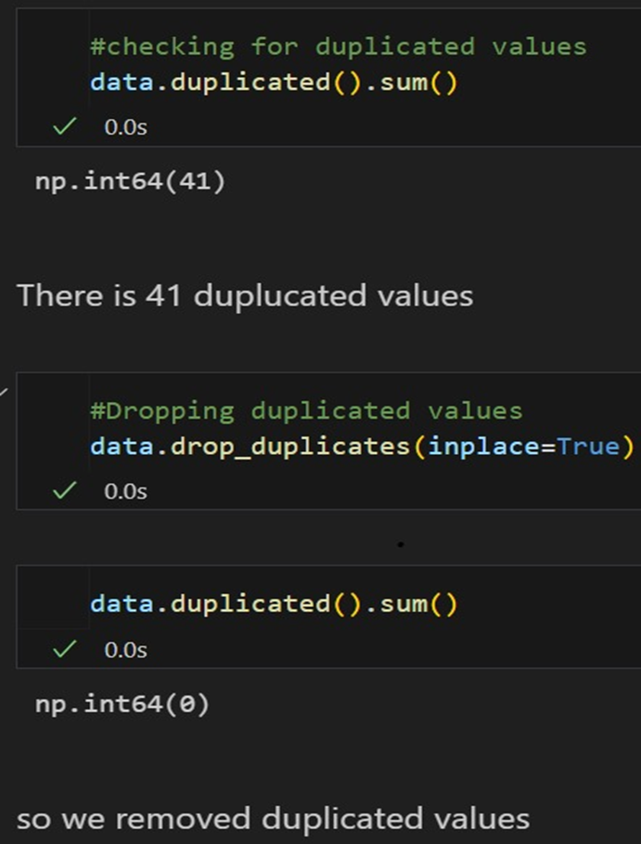
DATA PREPROCESSING
Dropped 41 duplicated values, accounting for only 0.43% of the dataset, ensuring a clean dataset for analysis.
Standardized the feature values to make them scale-free, facilitating better model performance and convergence.
Identified and dropped outliers using a standardized threshold, as they constituted just 1.43% of the data. This helps maintain the integrity of the model without losing significant information.

Slide 9
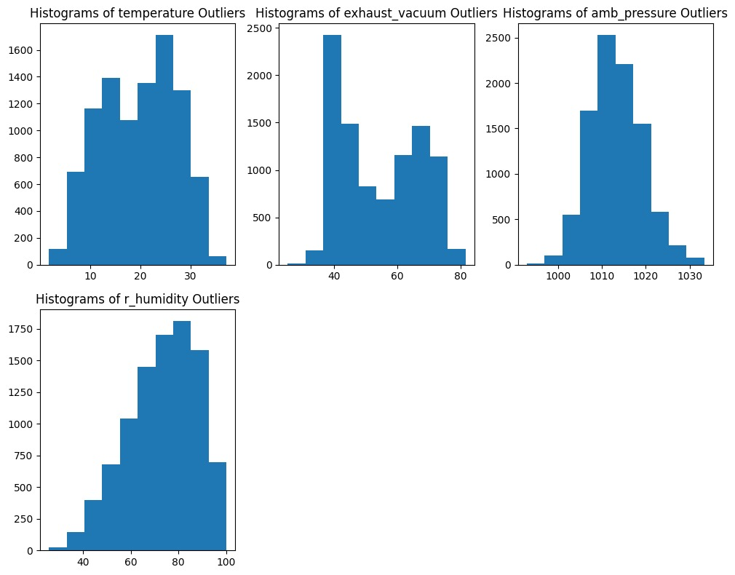
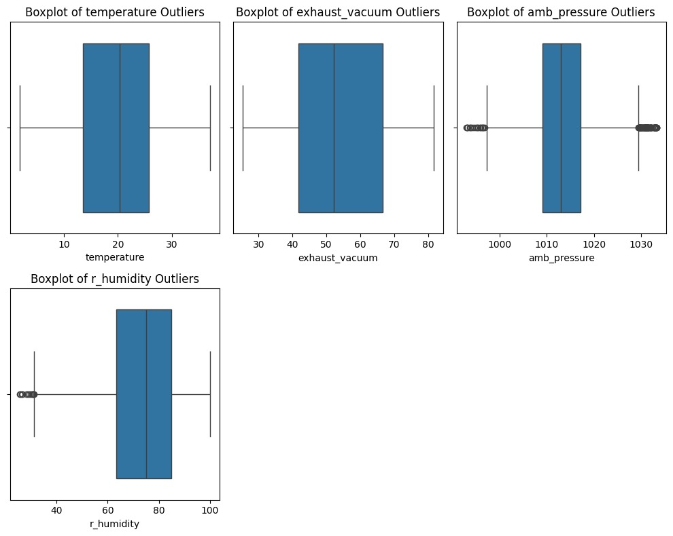
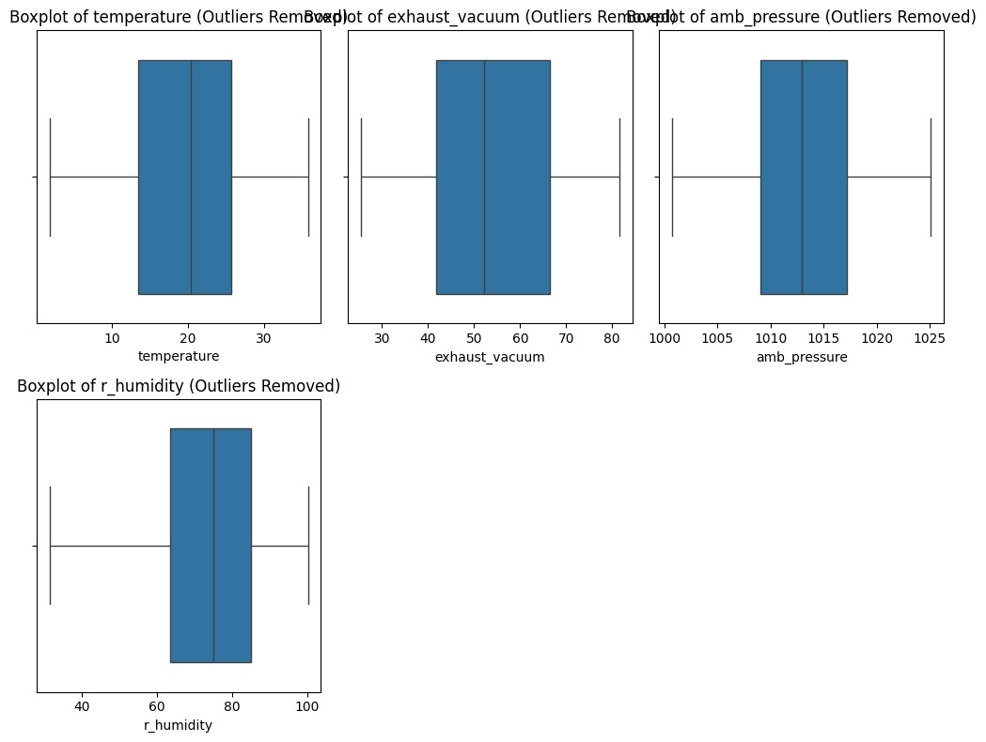
VISUALIZATIONS
HISTOGRAM BOXPLOT
BEFORE AFTER

Slide 10
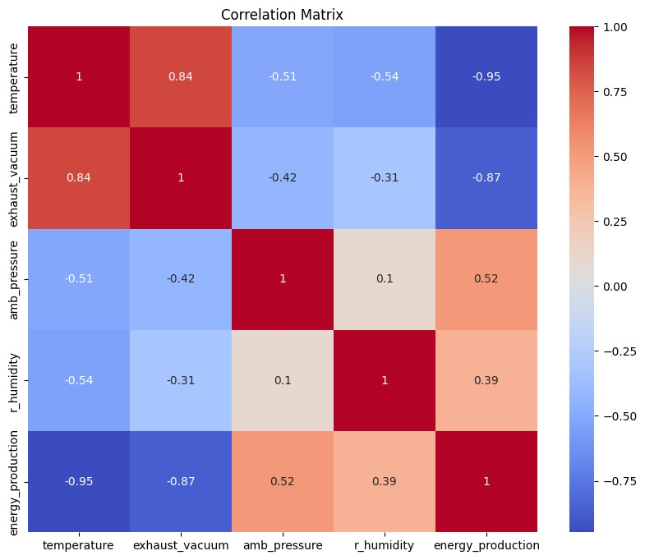
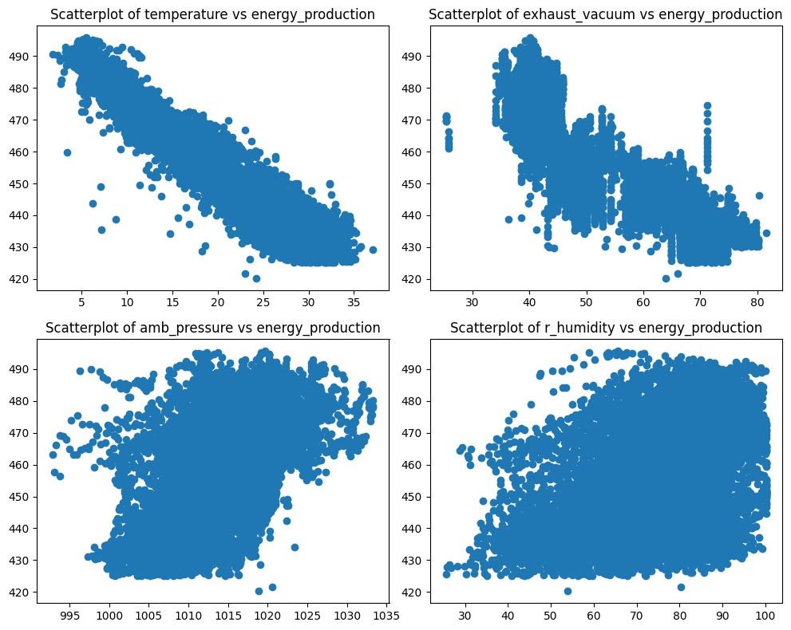
COLLINEARITY BETWEEN INPUT AND OUTPUT VARIABLE
CORRELATION BETWEEN VARIABLES

Slide 11
TRAIN & TEST SPLIT
The dataset was divided into training and testing sets to evaluate the model’s
performance effectively.
The data was split using a 70/30 ratio, with 70% allocated for training the model and 30% for testing.
A random seed was set to ensure reproducibility of the results during the split.
The training set comprises 6,577 samples, while the testing set contains 2,820 samples, providing a robust basis for model training and validation.

Slide 12
APPLYING ML ALGORITHMS
1. Linear Regression ordinary least squares (OLS):
It is a type of linear least squares method used to estimate the unknown parameters in a linear regression model. It operates on the principle of least squares, which involves minimizing the sum of the squared differences between the observed values of the dependent variable in the input dataset and the predicted values generated by the linear function of the independent variables. Some sources regard OLS as synonymous with linear regression.
2. Decision Tree Regression:
It is a type of linear least squares method used to estimate the unknown parameters in a linear regression model. It operates on the principle of least squares, which involves minimizing the sum of the squared differences between the observed values of the dependent variable in the input dataset and the predicted values generated by the linear function of the independent variables. Some sources regard OLS as synonymous with linear regression.

Slide 13
3. Gradient Boosting Regression:
It is a type of linear least squares method used to estimate the unknown parameters in a linear regression model. It operates on the principle of least squares, which involves minimizing the sum of the squared differences between the observed values of the dependent variable in the input dataset and the predicted values generated by the linear function of the independent variables. Some sources regard OLS as synonymous with linear regression
4. Support Vector Regression:
A Support Vector Machine (SVM) is a powerful machine learning algorithm widely used for both linear and nonlinear classification, as well as regression and outlier detection tasks. SVMs are highly adaptable, making them suitable for various applications such as text classification, image classification, spam detection, handwriting identification, gene expression analysis, face detection, and anomaly detection.

Slide 14
5. K- Nearest Neighbour Regression: KNN is one of the most basic yet essential classification algorithms in machine learning. It belongs to the supervised learning domain and finds intense application in pattern recognition, data mining, and intrusion detection. It is widely disposable in real-life scenarios since it is non-parametric, meaning it does not make any underlying assumptions about the distribution of data (as opposed to other algorithms such as GMM, which assume a Gaussian distribution of the given data). We are given some prior data (also called training data), which classifies coordinates into groups identified by an attribute. 6. Random Forest Algorithm: Random Forest algorithm is a powerful tree learning technique in Machine Learning. It works by creating a number of Decision Trees during the training phase. Each tree is constructed using a random subset of the data set to measure a random subset of features in each partition. This randomness introduces variability among individual trees, reducing the risk of overfitting and improving overall prediction performance.

Slide 15
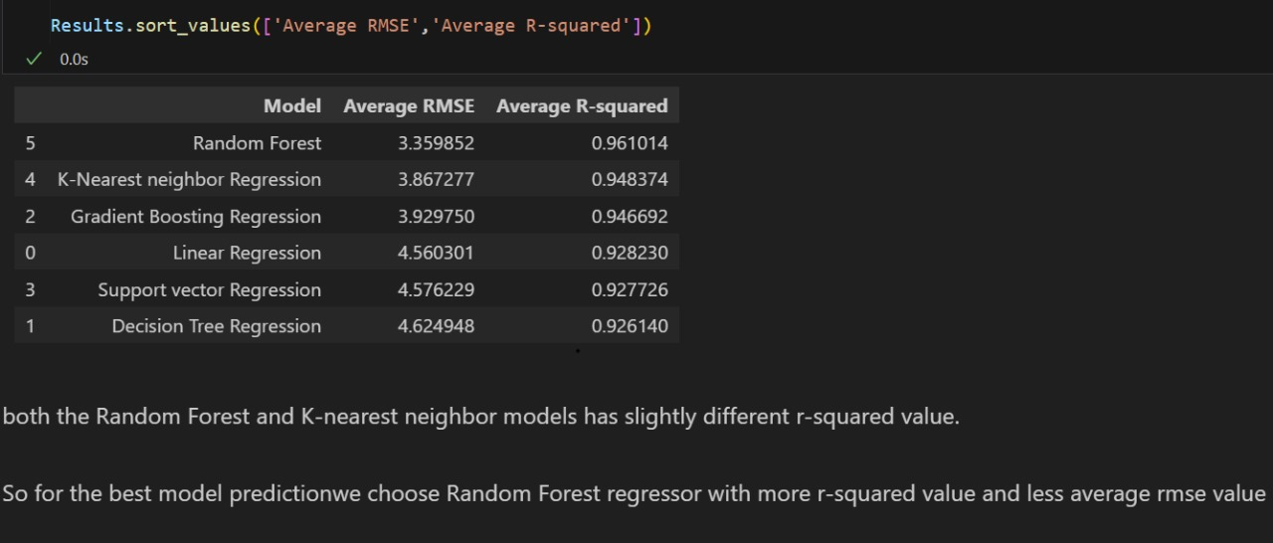
MODEL EVALUATION

Slide 16
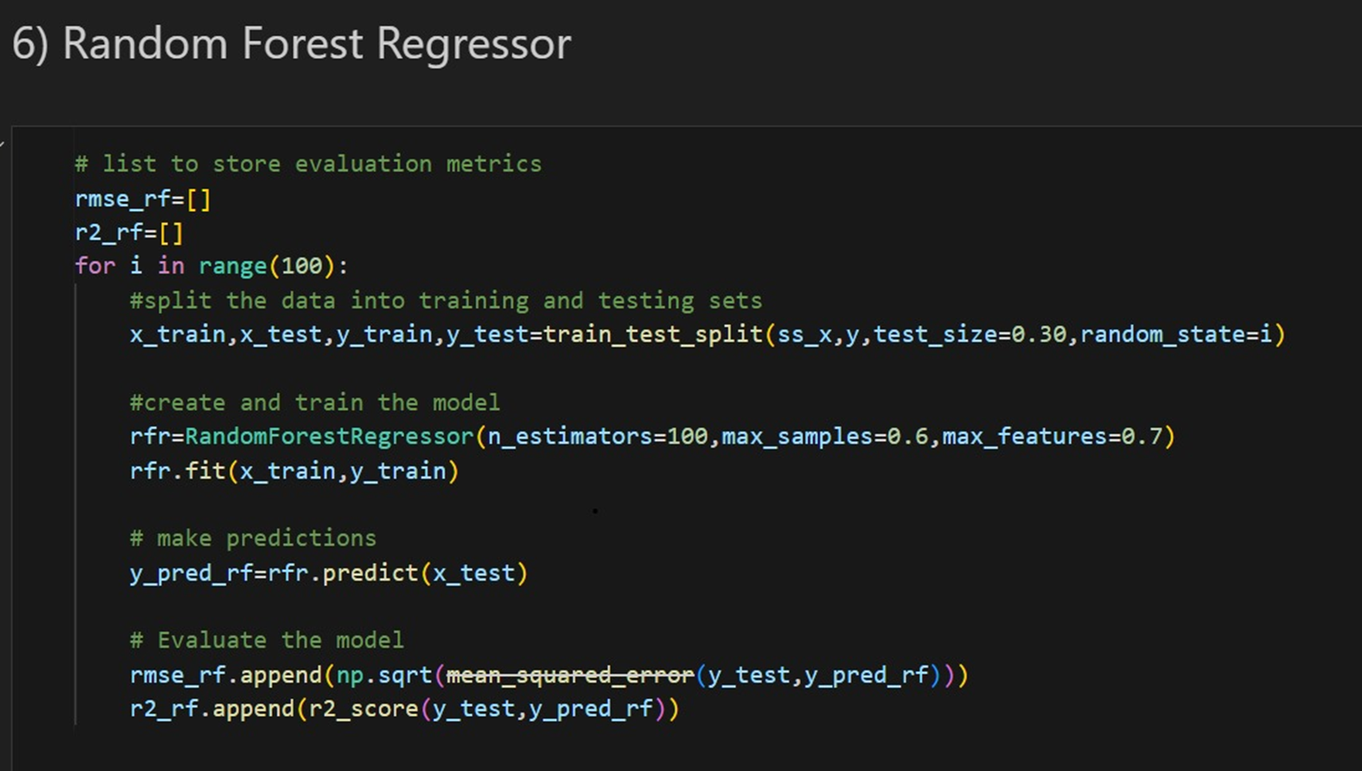
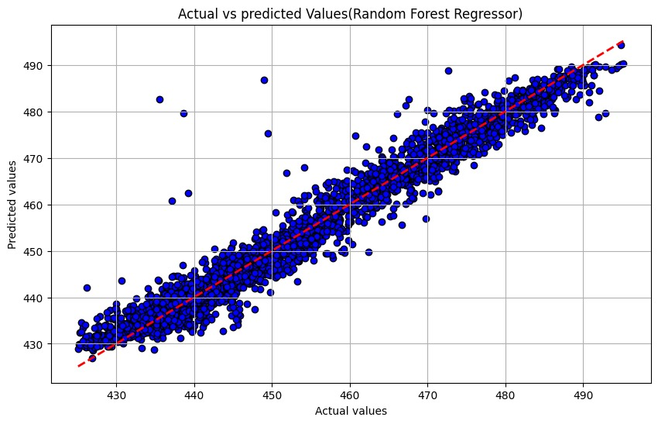
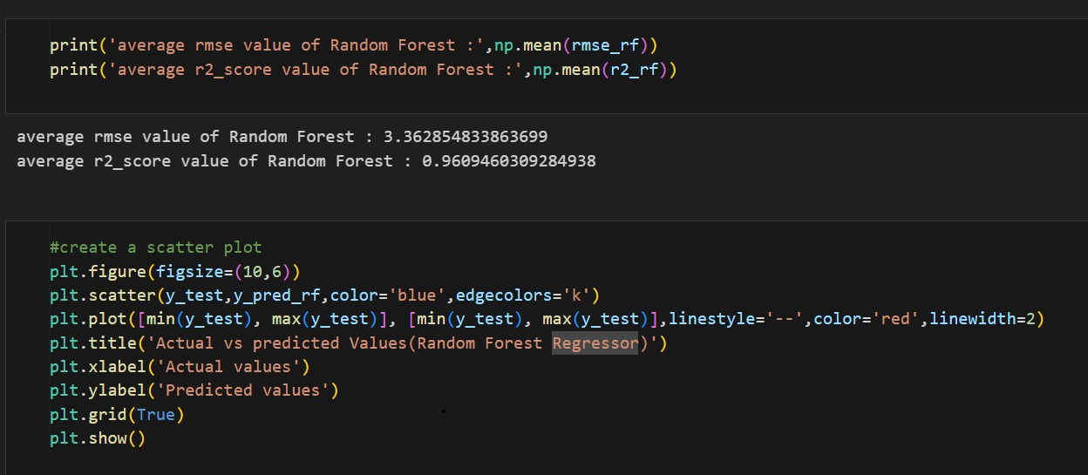
BEST MODEL SELECTION: RANDOM FOREST ALGORITHM
The best model selected for predicting energy production is Random Forest, which demonstrated the highest accuracy and the lowest Mean Squared Error (MSE) among the evaluated models.

Slide 17
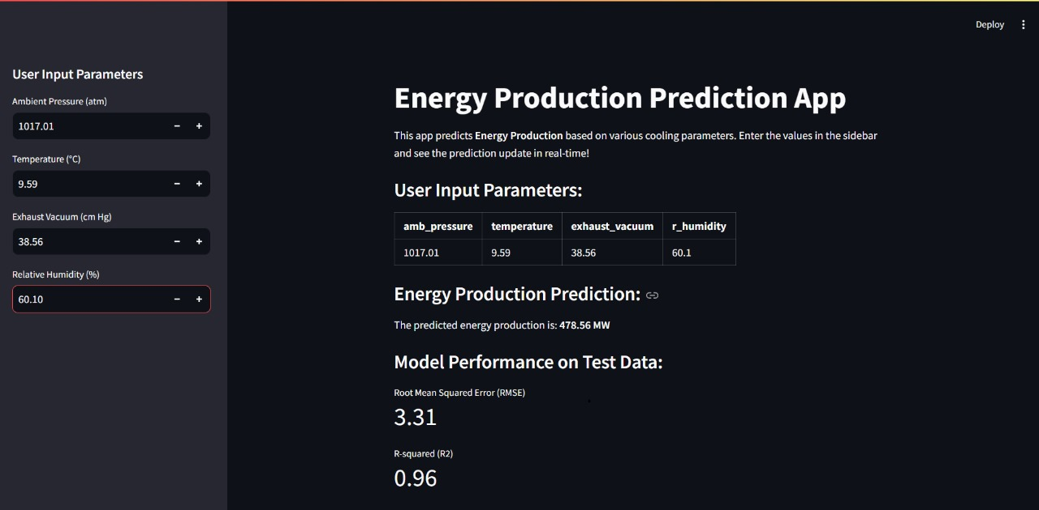
OUTPUT
Deploying ML model using streamlit is a streamlined approach that enables rapid prototyping and accessible,
user-friendly application for interacting with models.

Slide 18
CONCLUSION:
The project successfully developed a predictive model for energy production in Combined Cycle Power Plants using Random Forest Algorithm, achieving high accuracy and low MSE.
Through effective data preprocessing, including handling duplicates and outliers, we ensured a robust dataset for analysis.
Exploratory Data Analysis revealed significant correlations which were effectively managed during model training.
Model Performance:
Random Forest Model outperformed other models by effectively achieving an accuracy of 96% and a Root Mean Squared Error (MSE) of 3.31.
Future Work:
Future improvements could involve exploring additional feature engineering techniques, hyperparameter tuning, and validating the model with real-time data to enhance its robustness.
Significance:
The insights from this project contribute to optimizing energy production strategies, aiding decision-making in power generation for a sustainable future.

Slide 19
THANK YOU

